Slide 1
EARTHQUAKES

Slide 2
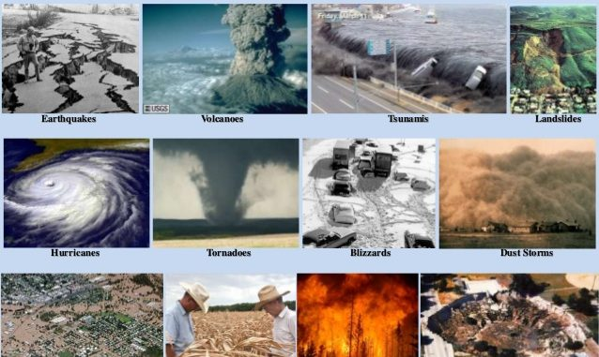

Slide 3
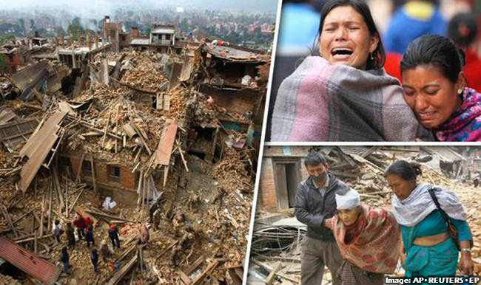
Earthquake

Slide 4
Earthquake is sudden release of energy accumulated in deformed rocks of earth’s crust causing the ground to shake. Earth experience 8000-10000 earthquakes annually.
Causes
Volcanic eruptions
Movement of tectonic plates
Isostatic adjustment
Construction of dams and blasts
Folding and faulting

Slide 5
Management
move out in open
Keep clam and keep away from windows, mirrors.
Buildings should be constructed according to NBC of india
Stand under strong beams
Creep under dining table or strong bed.
Cover your body with pillows, blankets or quilt to protect yourself from falling objects.
If travelling stop the vehicle away from buildings.
Stand away from tall building, electricity poles.
Buildings should be designed such a manner, they can withstand the stress of earthquakes.

Slide 6
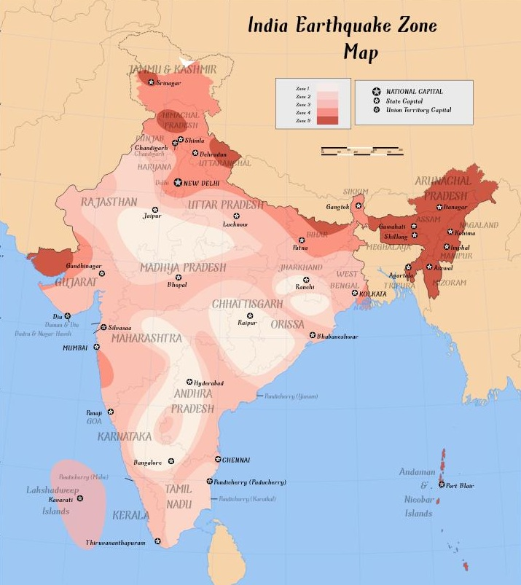

Slide 7
Effects of Earthquakes
Destructive effects of earthquakes include landslides, tsunamis, fires, and fault rupture. The aggressive shaking of the ground and sea leads to catastrophic destruction of manmade properties and personal injuries.

Slide 8
THANK YOU

